Slide 1


UPSkill PowerPlatform

Slide 2

Group Analytic Avengers
Members:
Fábio Costa
Daniel Sousa
Luís Gomes

Slide 3

Analytic Avengers Gym
Objective:
Implementing the various tools and capabilities of the Power Platform

Slide 4

Data Sources
Gymnasiums: https://www.ginasios.wiki/ginasios/
Population density: https://www.pordata.pt/municipios/densidade+populacional-452
Search popularity: https://trends.google.com/trends/

Slide 5
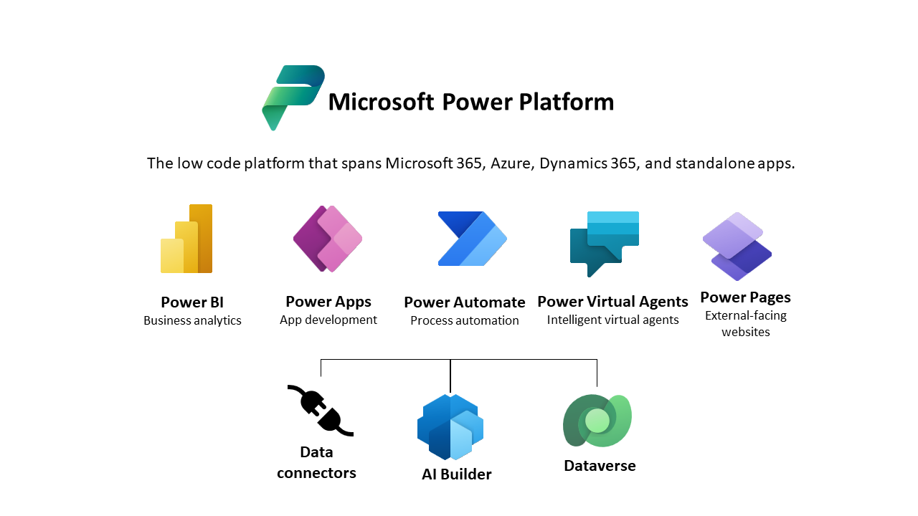
Power Platform Tools

Slide 6

Data Connectivity
Data Transformation
Data Visualization
Reporting
Sharing and Collaboration
Security

Slide 7
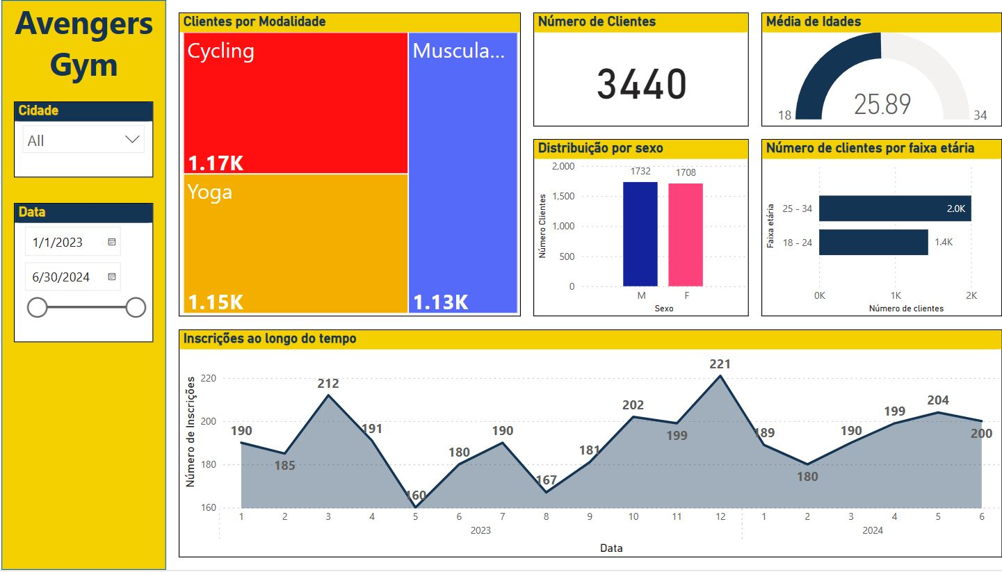
Power BI

Slide 8
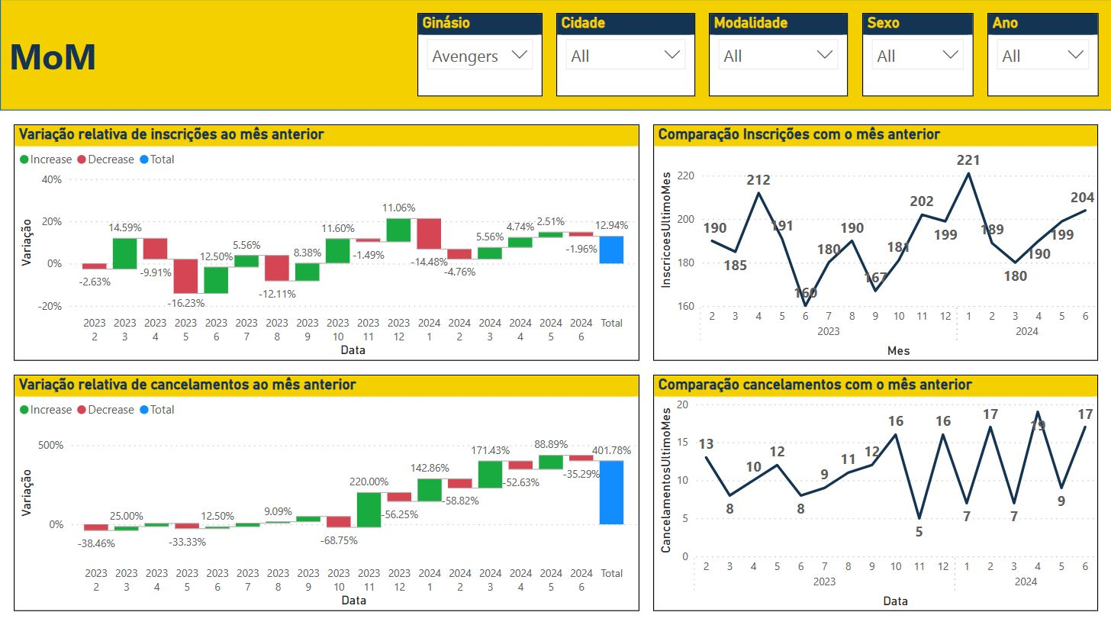
Power BI

Slide 9

Low-Code/No-Code Development
Data Integration
Cross Platform Compatibility
Security and Compliance
Colaboration and Sharing
Integration with other Microsoft Services

Slide 10
Power Apps - Tablet

Slide 11
Power Apps - Mobile

Slide 12
Power Apps – Model Driven

Slide 13

Workflow Automation
Integration
Templates
Aprovals
Business Process Flows
Task Automation
Security and Compliance
Collaboration

Slide 14
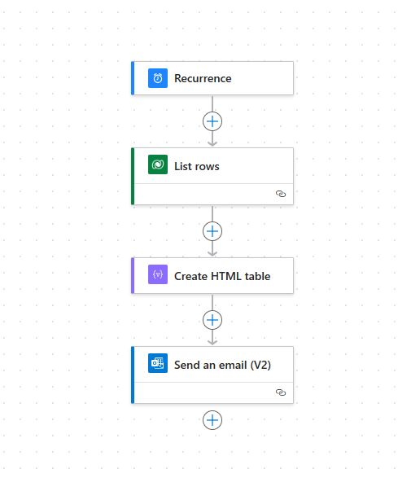
Power Automate – Schedule flow

Slide 15
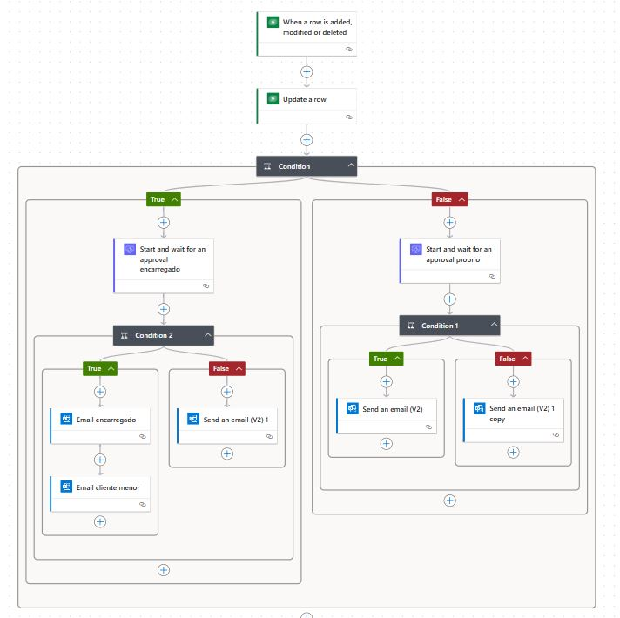
Power Automate – Approval flow

Slide 16

Low-Code/No-Code Environment
Workflow Automation
Data Integration and Management
Colaboration and sharing
Security and compliance

Slide 17
Copilot Studio

Slide 18

Templates and themes
Responsive Design
Integration
Content Management
Forms and Data Collection
Sharing and Collaboration
Security and Compliance

Slide 19
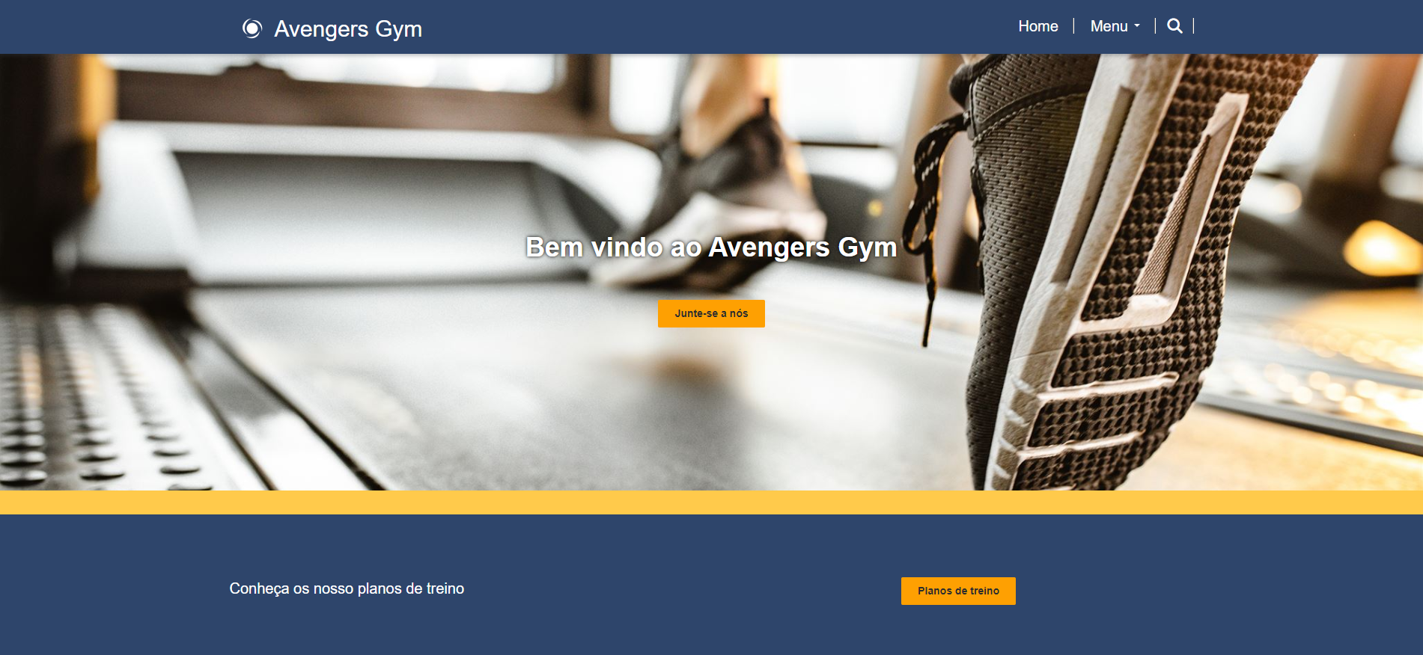
Power Pages

Slide 20

Conclusion
Power Platform allowed us to create solutions for various needs, from business reports, applications, automation of task, interactive chatbots and web portals.
The acquired skills will be very valuable to develop solutions for any obstacle we might face in the future as Power Platform Developers and in the IT area.
We look forward to continuing or progress.

Slide 21
Thank you for your time

